Slide 1
15th District PTA
Treasurer Training

Slide 2
Forms and Templates for Binder
Request/Authorization for Payment
Funds Received Form
Deposit Summary Form
District Membership Dues Payment Form
MemberHub - State & National Pd., Store
W9 Form
Officer List
Financial Review Form
Budget Template
Treasurer Report Template
Sales Tax Exempt Form

Slide 3
Budget
A budget shows a plan for how your PTA will raise money and spend money to implement the PTA mission. A budget does not dictate what your PTA must do. It simply represents what your PTA intends to do.
Consider your PTA’s goals and the resources needed to achieve your planned activities.
Study the previous year’s budget and treasurer’s report to determine how well that budget met your PTA’s needs.
Determine your PTA’s projected financial needs, taking into consideration the funds needed for the approved programs, fundraising events, and leadership development. Determine how funds will be raised to meet these requirements.
Develop a one-year budget that shows existing funds, as well as projected funds raised and anticipated expenditure or receipts for the year’s activities.
Present the draft budget for approval to the PTA board or executive committee. Incorporate feedback and then present the draft budget to the PTA membership during a general meeting where a quorum is determined to be present. A majority vote of the members present and voting is required for adoption.

Slide 4
Possible Income Items
ALWAYS ON THE BUDGET
Membership Dues
Fundraiser Approved by District
DEPENDS ON THE PTA
School Pictures
Donations
Fundraisers that are not approved by district – Restaurant Nights, Box Tops, Amazon Smile, or Kroger Rewards
Concessions
Spirit Wear

Slide 5
Possible Expense Items
ALWAYS ON THE BUDGET
Membership
Fundraiser
PTA Insurance
Programs – KY Kids Day, Family Night, or whatever programs your PTA is doing.
Start Up Funds for Next Year
Emergency Reserve of Contingency Fund
DEPENDS ON THE PTA
Programs – KY Kids Day, Family Night, or whatever programs your PTA is doing.
Office Supplies
Training
Concessions
Yearbook
Teacher Appricaition
Spirit Wear

Slide 6
Emergency Reserve/ Contingency Fund
This fund is intended to serve as a means to retain financial stability in the event of an unforeseen circumstance such as an unplanned expense arising form a project or unexpected increase in inflation.
These funds can be moved to another budget line item without going back to the membership for approval. The PTA board does this approval.

Slide 7
Restricted Funds
The IRS has strict rules on restricted funds. When money is raised for a specific purpose the money must be spent on that purpose. It does not matter if it is one year, five years or twenty-five years from now.
Examples – Playground, garden, and large projects.

Slide 8
Amending the Budget
The budget is only an estimate of the planned expenditures for the year. When there are additional expenses or a change in an allocated expenditure, the budget may need to be amended by a vote of the association at any regular meeting, or at a special meeting called for that purpose.

Slide 9
Important Items to Remember
Except for large restricted budget items – what is raised in the school year should be spent on the school year.
Your balance at the end of the year is part of your budget. It is listed on your budget.
The Income and Expenses must equal zero when your budget is created.

Slide 10
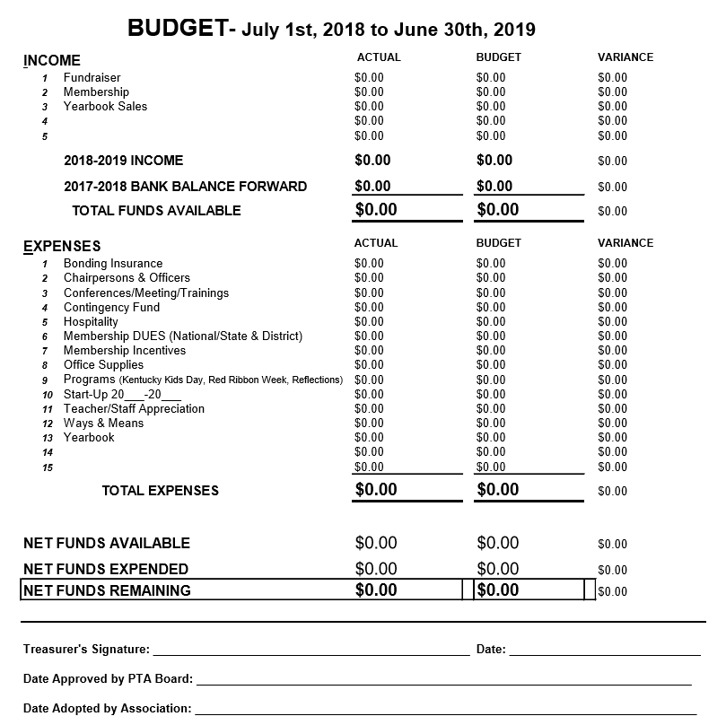
Budget Spreadsheet in the KY PTA Toolkit!

Slide 11
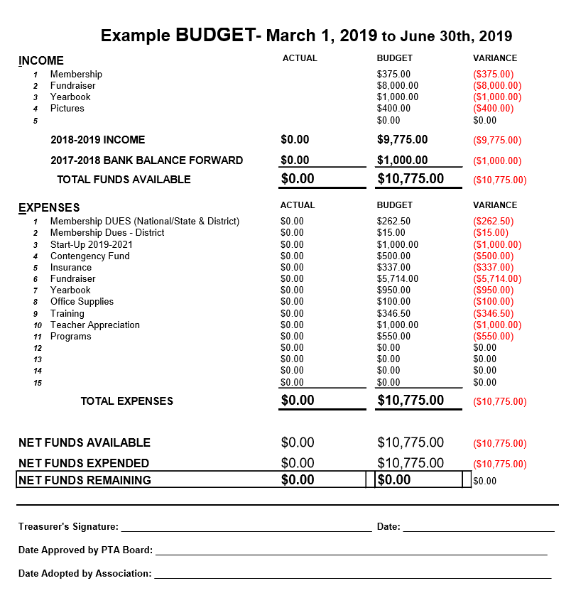

Slide 12
PTA/PTSA Insurance
Association Insurance Management (AIM)
Policy cost is $320.00 for all local units
Coverage for Directors and Officers
Coverage for Liability
Make sure insurance is up to date
Mandatory for RedBook
Due September 1st
Insurance Form in the KY PTA Toolkit!

Slide 13
Deposits
Funds Received Form - Complete for every deposit made
2 Signatures required - 1 must be board member, count before taking money away from the school
Teachers - can watch, verify, and write on form
Don’t leave funds in school safe, deposit by night drop or immediately after event.
Only PTA/PTSA Funds in the PTA/PTSA Account
NSF checks - develop policy in standing rules (fees to collect, letter in Financial Matters)
Deposit Summary Form - Complete for every Funds Received Form it if there are multiple budget lines affected (attached deposit slip from Bank to form)

Slide 14
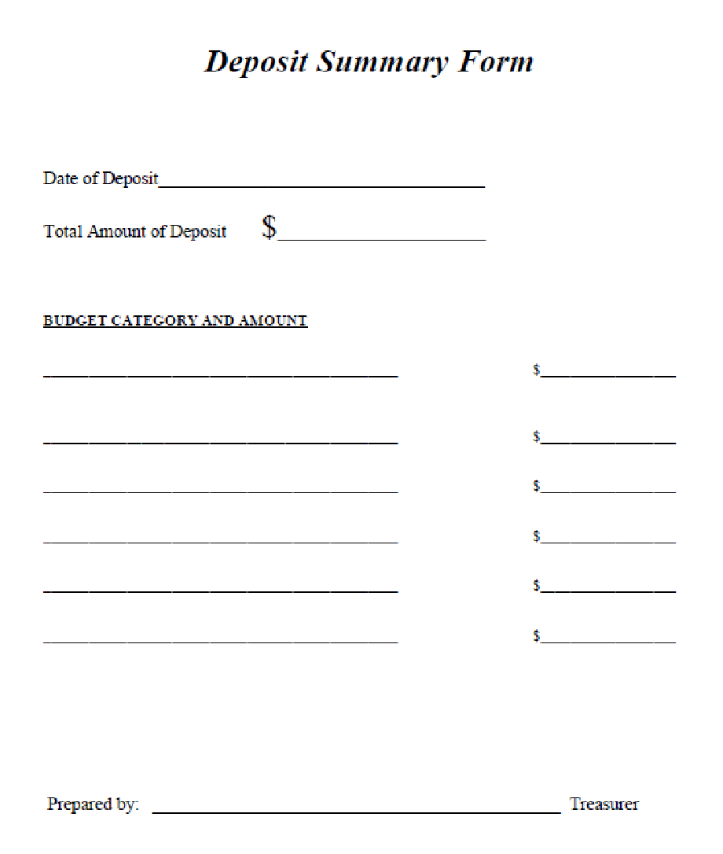
Remember –
Money should be deposited as quickly as possible.
Form in the KY PTA Toolkit!

Slide 15
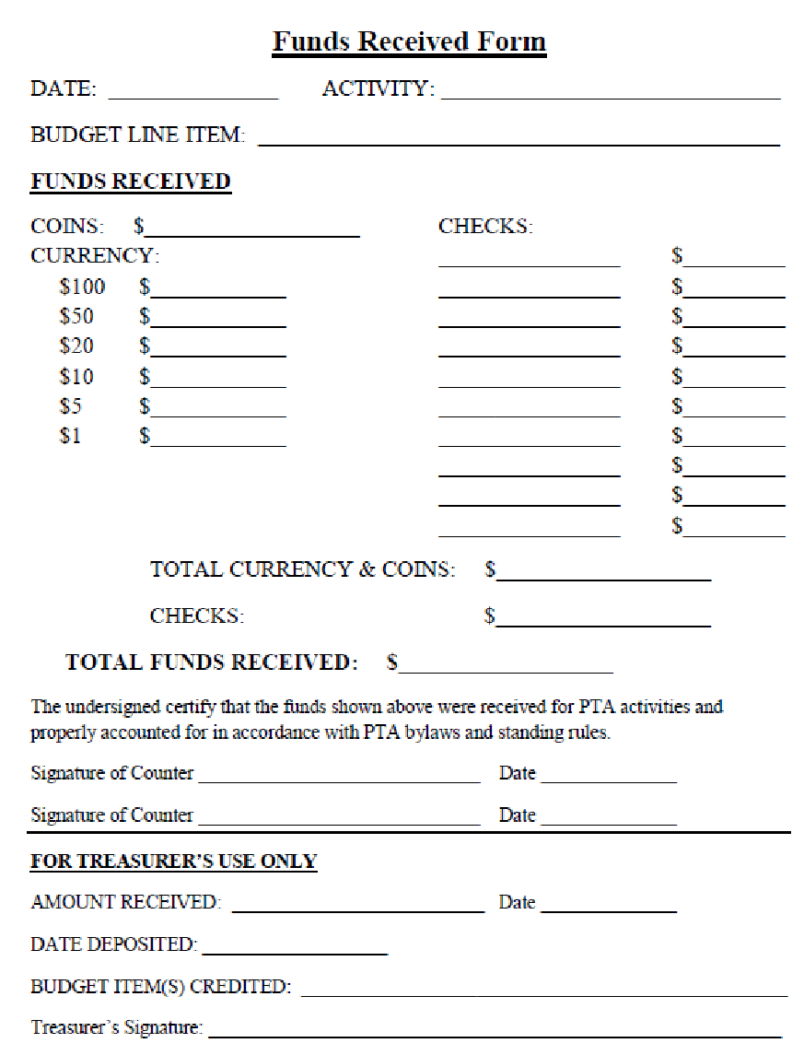
Make sure that two people count the money and sign the form.
Remember that JCPS employees can not handle money. They can watch you count if another person is unavailable. However, they would sign the form stating “visually watched money counted – did not actually handle money.”
Form in the KY PTA Toolkit!

Slide 16
Reimbursements
Request/Authorization for Payment Form - All check/expenses/disbursement should have a completed form signed by the person requesting and approved/signed by the president
Attach all original receipts/invoices
NO DEBIT/ATM CARDS
No Blank checks or made payable to cash
No paying in cash, no gift card purchases, no Paypal
Cash Box Requests - deposit nightly, create a deposit summary form, deposit for same amount, make sure 2 people verify $$
Sales Tax Exempt Form - standing rule about paying sales taxes for purchases.
Can not reimburse – employees of any KY school system.

Slide 17
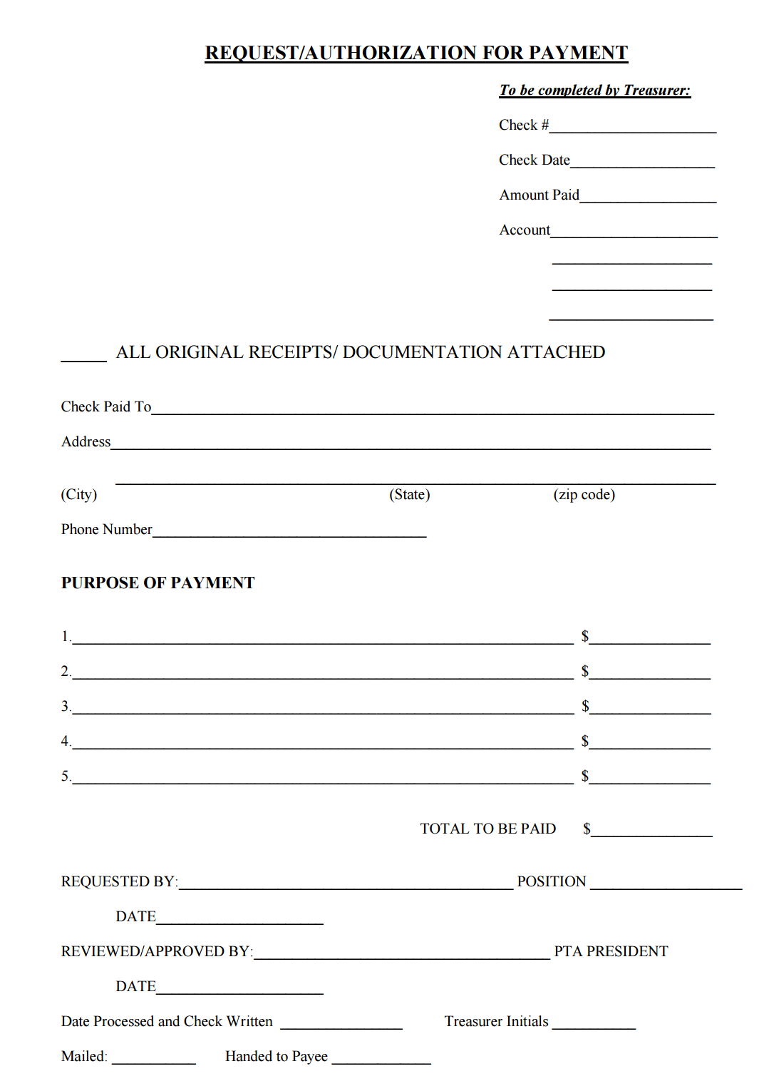
Anyone who is requesting payment must fill out this form.
PTA President must approve request and sign the form.
Form in the KY PTA Toolkit!

Slide 18
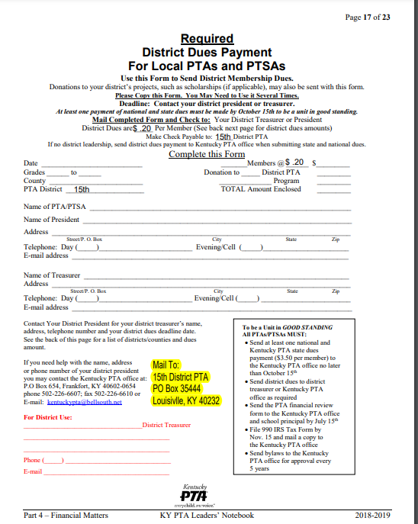
Membership Dues
National and KY PTA dues are sent
by MemberHub.
15th District PTA dues have to be done by check.
Can be found at http://15thdistrictpta.org/membership/forms-paperwork/

Slide 19
Monthly Treasurer Reports
Reconciliation - Previous Month statements reconciled and balance (provide copy of budget and bank statement)
Budget balance on date = $0.00
Outstanding Deposits = $0.00
Checks not cleared previous Month = $0.00
Ending balance on last day of month = $0.00
Current budget and check register (month to date of current meeting - copy of budget and online printout of transactions if available)
Outstanding Deposits = $0.00
Checks not cleared current month = $0.00
Budget balance on date of meeting = $0.00
Business items such as motion for amendments to budget
Attachments
Bank statements since last reports (online printout for partial month)
Check register showing running balance
Budget reports for reconciliations and current balance for meetings
Signed: _______________________________ Date: ______________________________
.

Slide 20
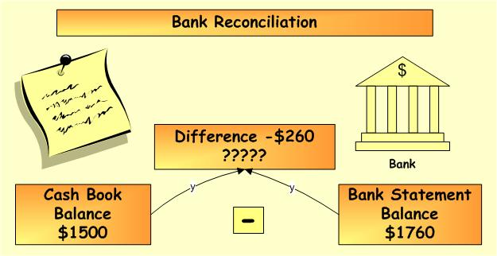
Bank Reconciliations
Monthly bank reconciliations should be performed to account for expenses and income with any outstanding checks.
Treasurer Reports - present monthly to board and at general membership meeting (can be email virtually or posted in area of the meeting)

Slide 21
Financial Review
Form & Instructions in the KY PTA Toolkit!
Due By July 15th
Who needs copies:
Kentucky State PTA - Email a copy to kentuckypta@bellsouth.net or upload in Memberhub
After emailing it, log in to memberhub and submit it under Audit/Financial review
15th District receives a copy
Principal
Treasurer Binder
Make sure you present the review at the first general meeting.
Incoming treasurer should not accept/receive the checkbook and records until a FInancial review has been completed and he/she has been given a copy of the completed form.

Slide 22
Financial Review Cont.
Kentucky PTA bylaws require every local unit to complete a Financial Review and submit a completed form to the Kentucky PTA. A Financial Review must be completed every year even if the current treasurer has been elected for another term and/or if you have 2-year terms.
The purpose is to certify the accuracy of the books and records of the treasurer and to assure the membership that the association’s resources/funds are being managed in a business like manner the regulations established for their use.

Slide 23
What you Need for the Financial Review
The fiscal year is July 1st through June 30th, check your bylaws to confirm fiscal year dates. The treasurer should provide the following to the reviewers:
A copy of last year’s financial review,
A copy of the approved budget for the year along with board minutes approving it.
All approved board and executive minutes.
Treasurer monthly reports/reconciliations.
Checkbook with register including voided checks.
All bank statements for the year for all accounts including savings.
All funds received forms along with deposit receipts that include the signatures from 2 people.
All reimbursement and authorization forms signed by the President with receipts attached.
Current bylaws and standing rules.
A completed current year financial review without signatures. The form can be found on the KY PTA website at www.kypta.org

Slide 24
990N
Go to (1) https://file990.org (2) log-in or enter your EIN and e-mail address, (3) information should auto-populate (double check information), (4) make sure box is green next to $50,000 or less, (5) click next and fill out the remaining requested information, (6) click proceed to payment (it should always come up as zero, if not contact your district or state treasurer), (7) Click SUBMIT filing. Instructions found at www.kypta.org
Completing the e-Postcard requires the six items listed below:
EIN Number
Tax Year
Legal name and mailing
Name and address of a principal officer
Website address if the organizations has one
Confirmation that the organization’s annual gross receipts are less.
Due November 15th

Slide 25
990EZ
File 990EZ if gross receipts are greater than $50,000 but less than $200,000
IRS.gov
https://www.irs.gov/pup/irs-pdf/i990ez.pdf
Mail the form and completed schedules to:
Department of the Treasury Internal Revenue Service Center
Ogden, UT 84201-0027
It is recommended that the tax return be sent via certified mail with return receipt to maintain proof of the mailing date.
Due Date November 15th

Slide 26
Treasurer Resources
Financial Matters - www.kypta.org or go to the toolkit at https://toolkit.kypta.org/login.php
National PTA E-Learning Treasurer Courses -
https://www.pta.org/home/run-your-pta/elearning
Local unit Treasurer
Quick Guide to budget basics
501(c) 3 Basics for Local PTA’s
Preventing Theft in Your PTA
National PTA Back to school Kit (Finance)
www.ptakit.org

Slide 27
Questions
There are no dumb questions!!
In fact someone else out there might also have that same question and be too scared to ask it.
Be Brave & Ask!!!!

